Slide 1
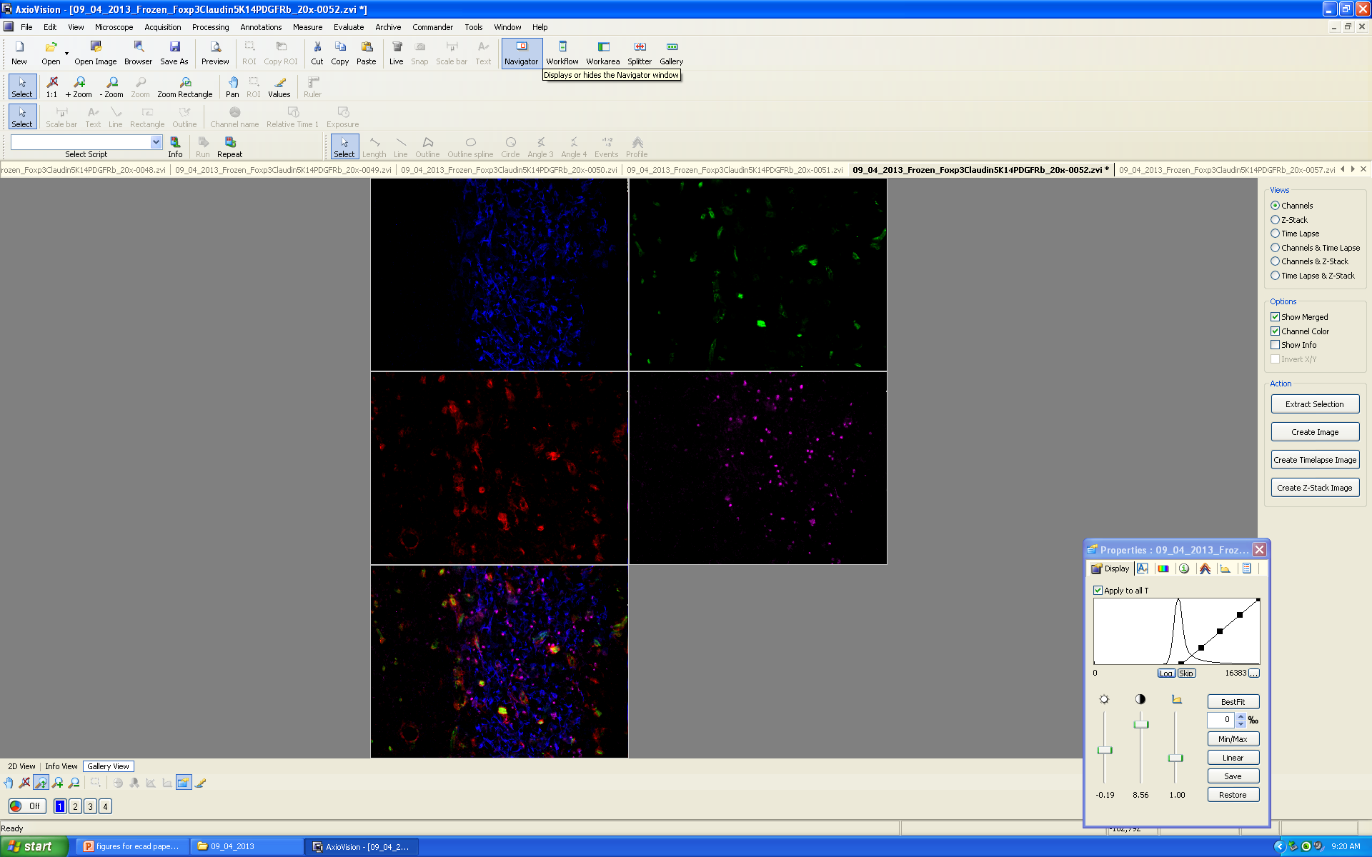
K14-Blue Claudin5-Green PDGFRb-Red Foxp3-Purple 20x Lab Microscope Frozen Antibody Set 1
Cellular Ecology of the Mouse Thymus
Mary Browning
3/17/2015
Mary Browning
3/17/2015

Slide 2
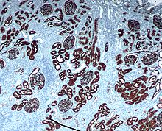
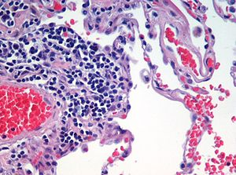
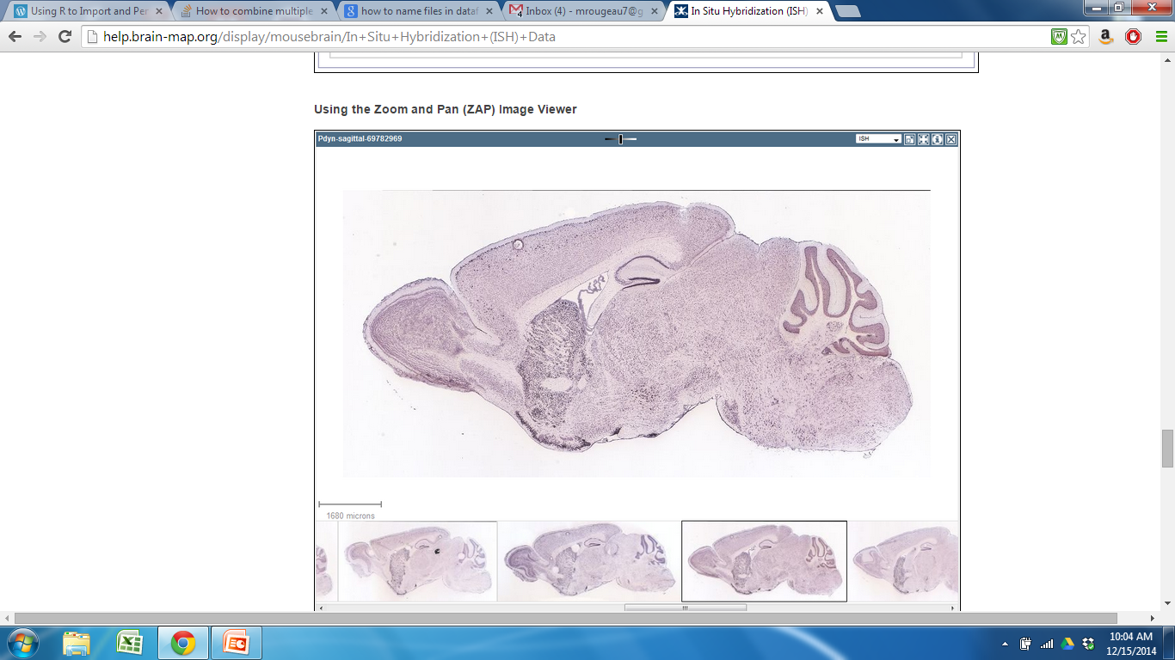
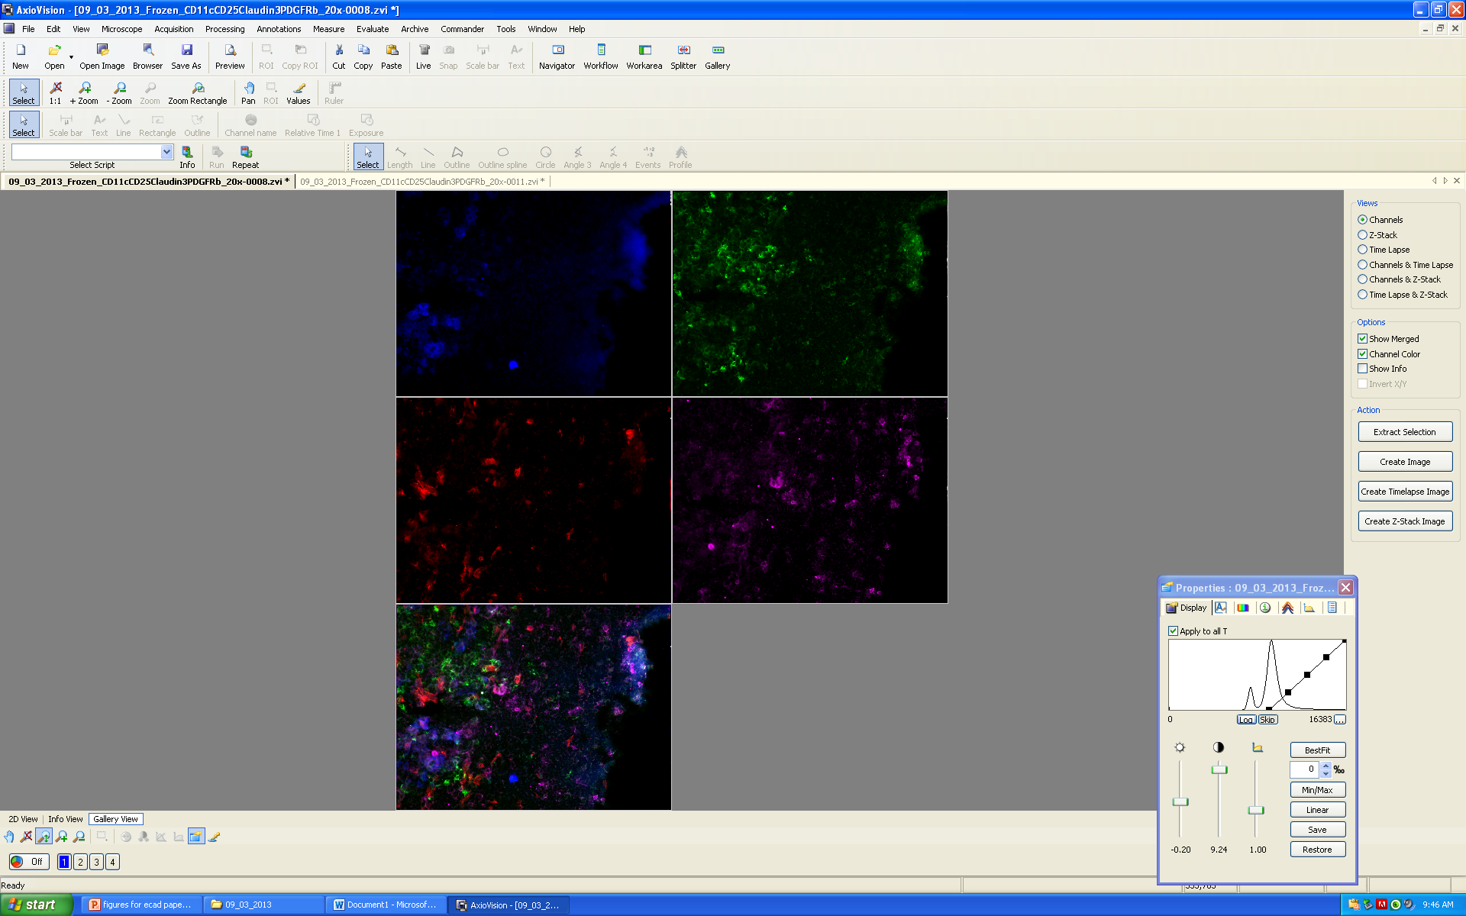
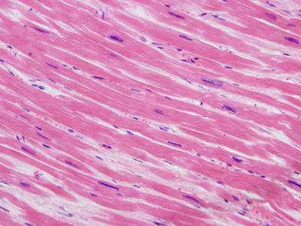
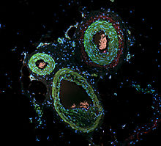
Organization of Organs
Human Kidney; IHC
Human Lung Tissue; H&E
Mouse Brain; In Situ
Mouse Thymus; Immunofluorescence
Heart muscle; H&E
Actin in smooth muscle of skin; Immunofluorescence

Slide 3
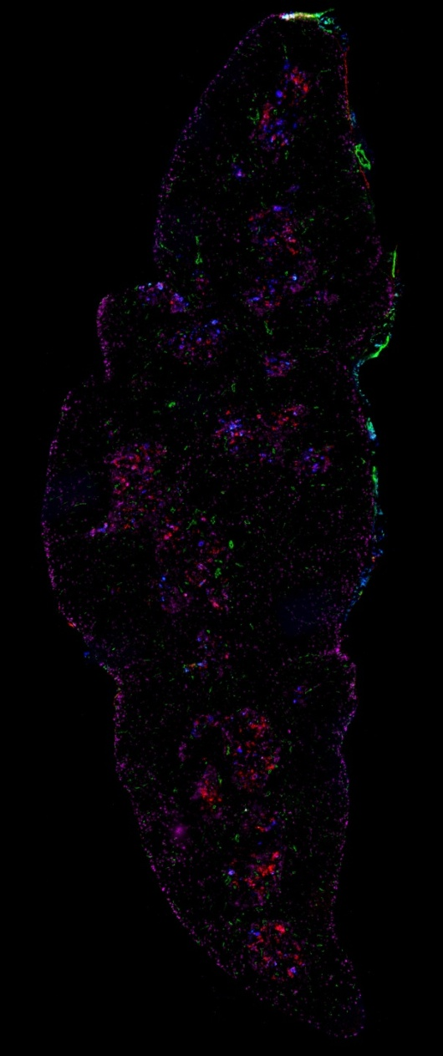
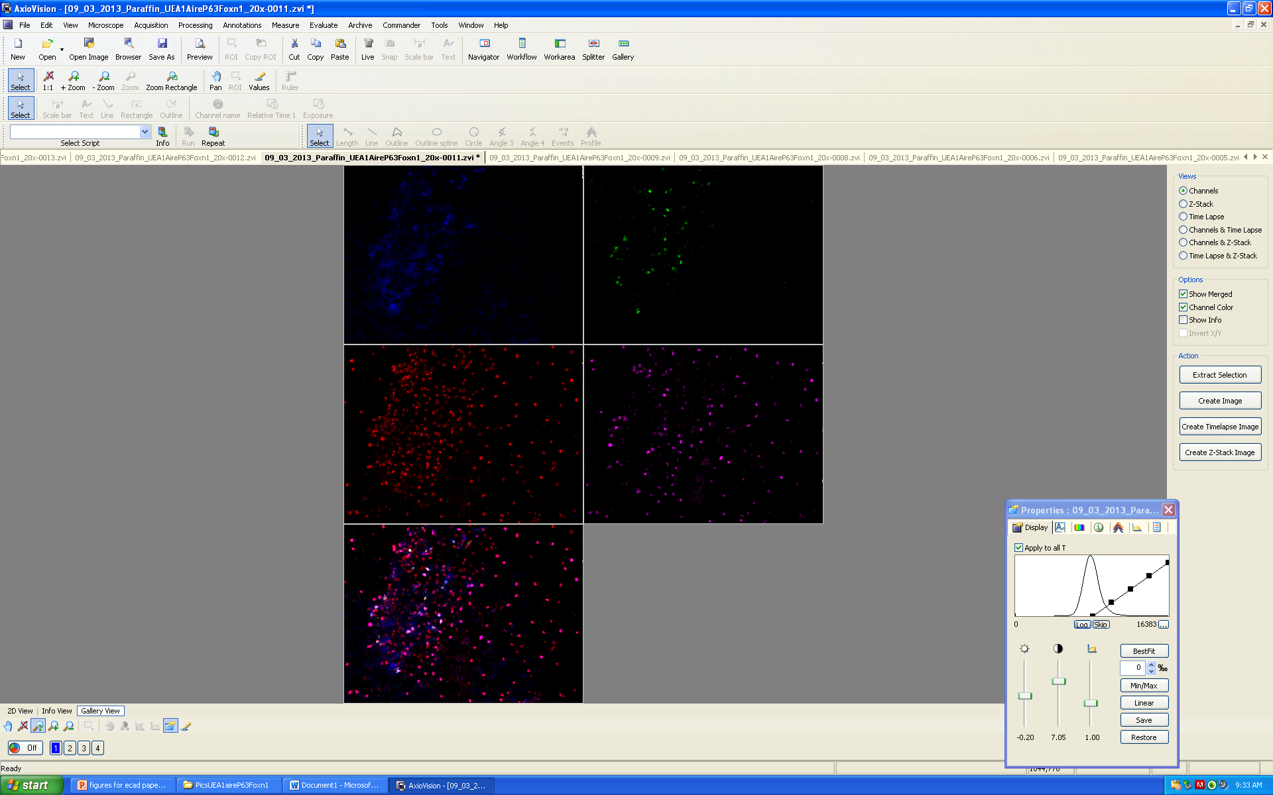
Cell Types in the Thymus
P63
P63, UEA1, Claud34, CD31

Slide 4
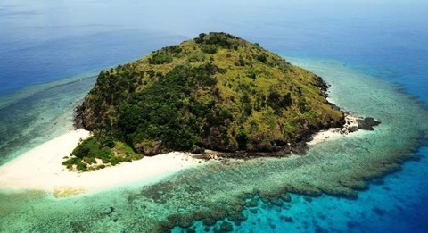
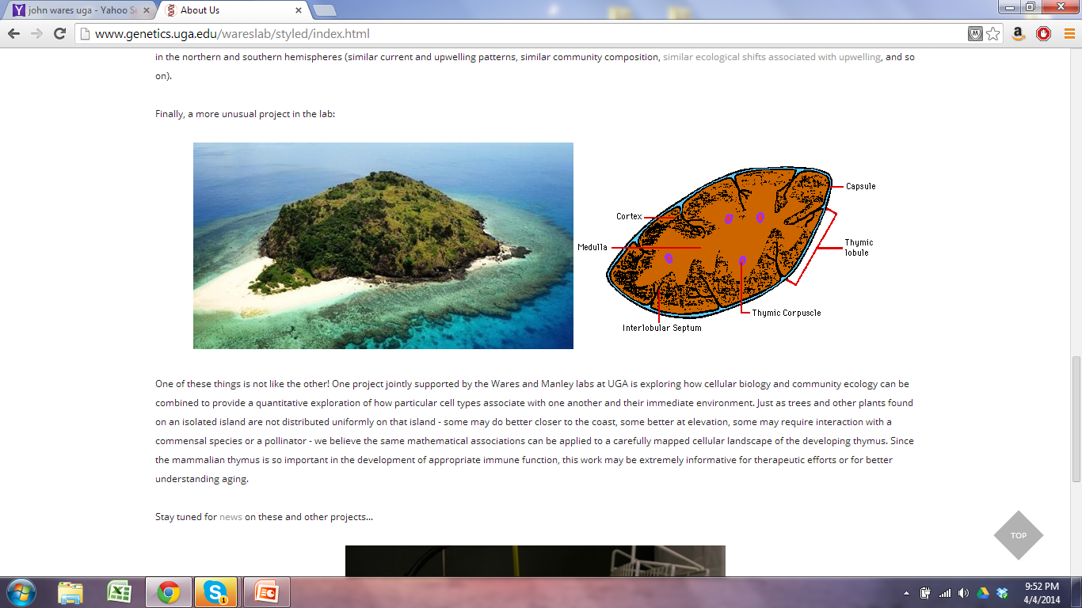
How can we quantitatively evaluate organization of cell types in organs?

Slide 5
Ecosystem | Organ-Thymus
Do species aggregate or is distribution random? | Beyond regional organization, are cells in the thymus organized a certain way?
How is diversity distributed across the community? | Are patterns of organization consistent throughout the thymus? Between individuals? Random?
How does removal or addition of a species affect organization? | How does a wild-type organ differ from a mutant? Diseased organ?
Are there keystone species? | How does removal of a cell type affect organization?

Slide 6
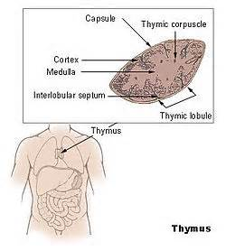

Background
Why is the thymus important?
Essential for proper immune system function
Programs T cells
Loss of functional thymic activity = reduced functional T cell output
Susceptibility to diseases
Autoimmunity

Slide 7
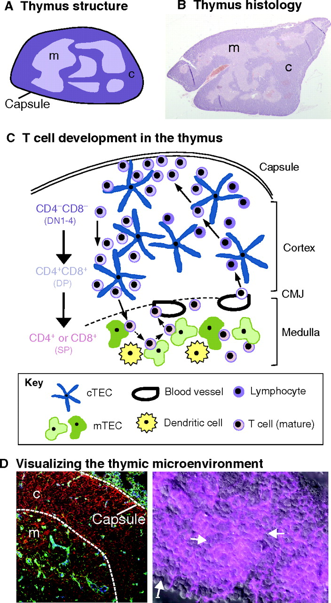
Thymus Cell Types and Migratory Pathway of T cells (Adult WT Thymus)

Slide 8
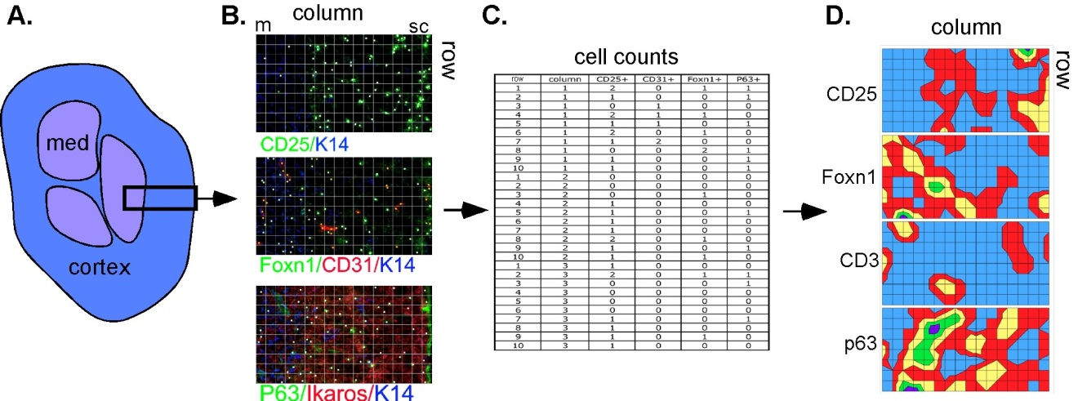
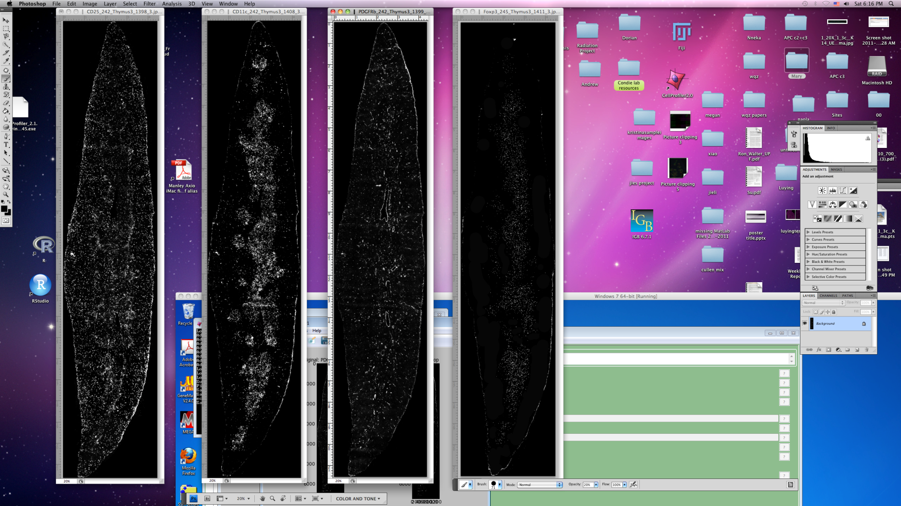
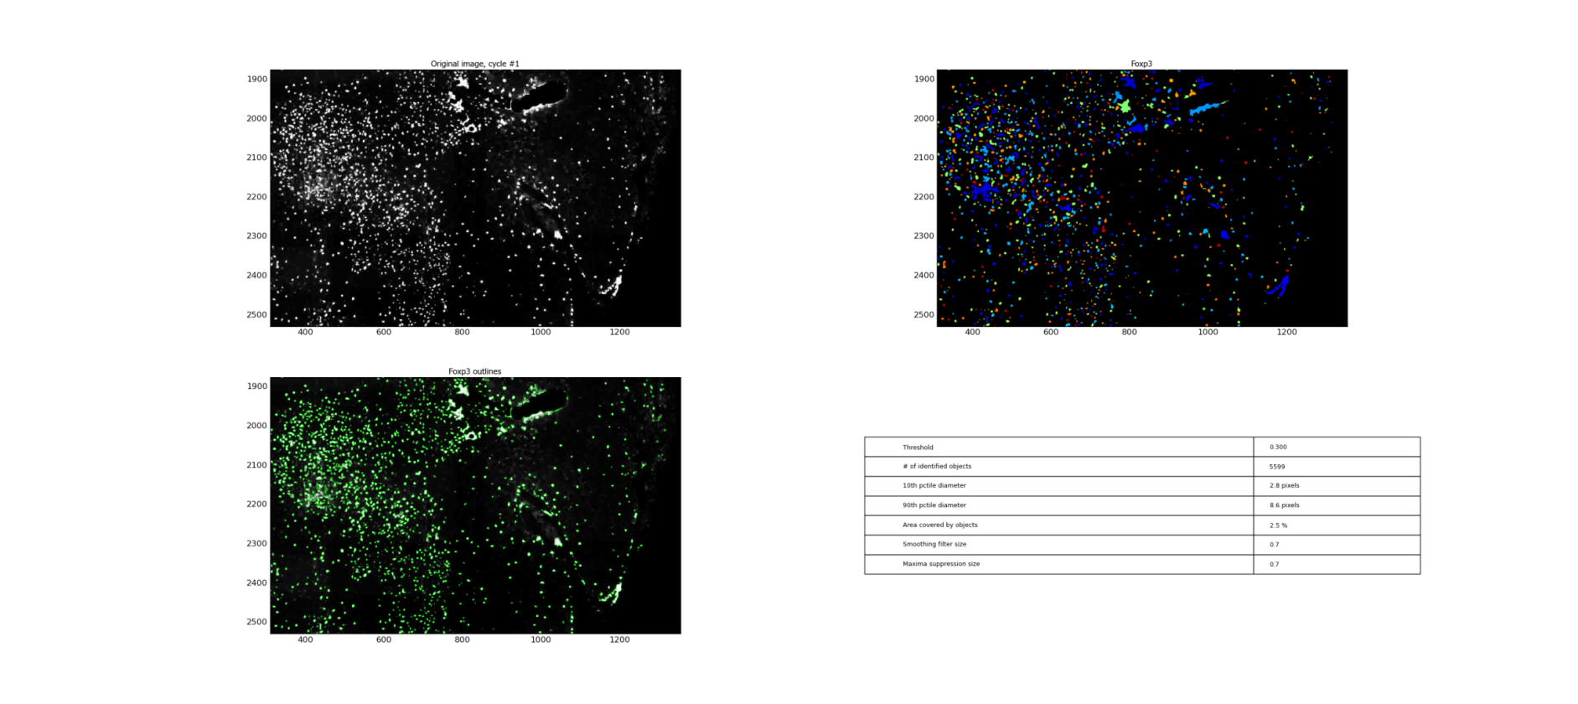
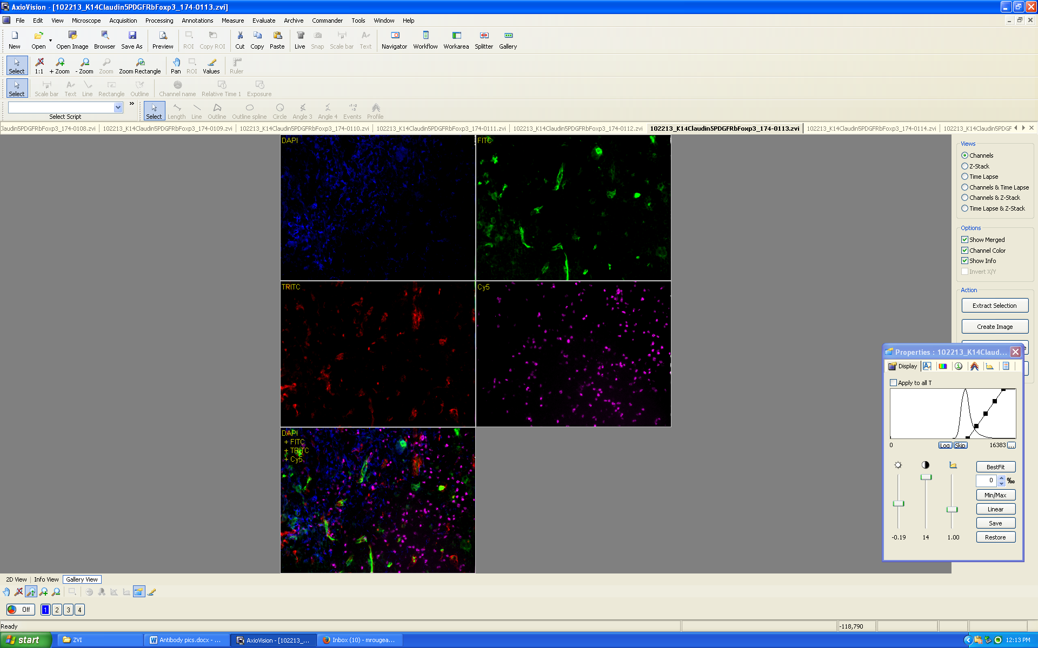
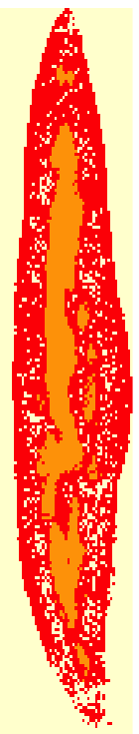
Overview of Methods-Identifying and analyzing cell types
Step 1 Step 2 Step 3 Step 4
Cut sections and
stain with antibodies
Take pictures
with microscope
Recreate section and perform
cell counts in CellProfiler
Perform spatial
analysis
Notes:
GOAL:IDENTIFY MANY CELL TYPES (increased statistical power for analysis)
Take middle sagittal sections of 1 month old wild type left lobe thymus and stain them with antibodies that bind to specific cell types
Take pictures with microscope along the entire thymus section
Piece them together using PTGui (panaromic pic stitching software) and use Cell Profiler (cell counting program) to perform cell counts on sections
Use cell location and abundance info from these sections for spatial analysis, this image is showing a heat map of different cell markers

Slide 9
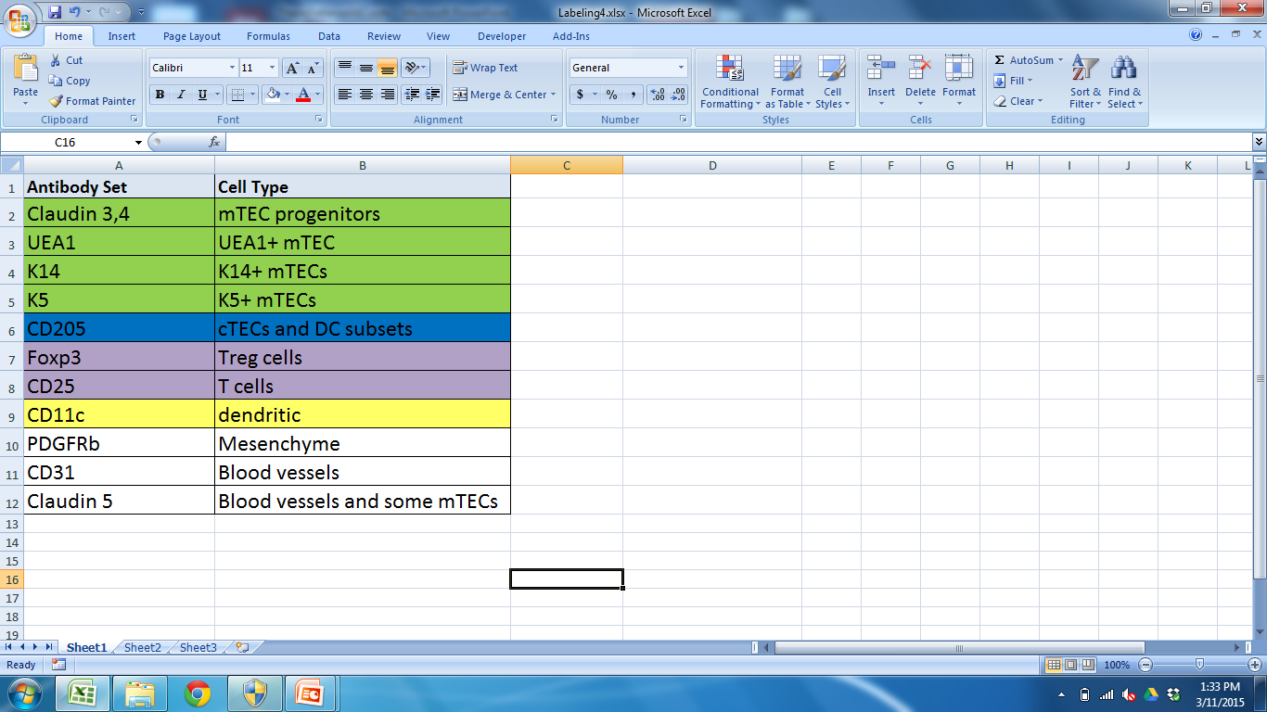
Cell markers included in analysis

Slide 10
Goal: Develop a quantitative model to characterize the organization of cell types in a mouse thymus.
Spatial and compositional clustering (K means)

Slide 11
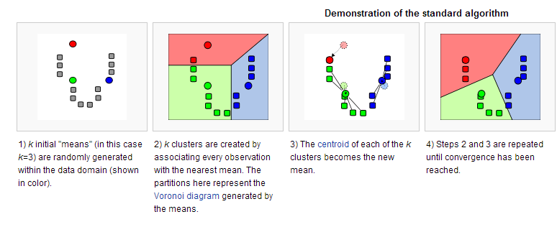
K means Clustering
http://en.wikipedia.org/wiki/K-means_clustering
Notes:
K-means clustering is a data mining technique that uses an algorithm to cluster observations with observations they are most similar to
The algorithm clusters observations into k groups, where k is provided as an input parameter.
Minimize difference within a cluster and maximize difference between

Slide 12

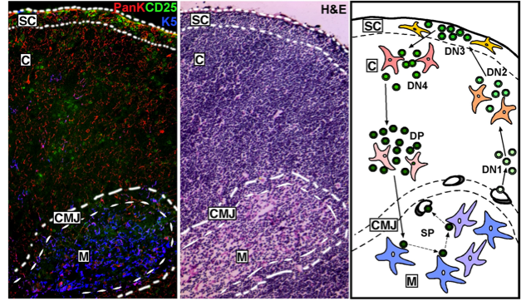
K means clustering
Regions
Cortex, Medulla, Subcapsular region, CMJ
Can these regions be computationally reproduced?
Do we identify cryptic information (other regions or subregions?)
Is pattern consistent throughout thymus? Between samples?
Notes:
Apply K means clustering to our dataset that contains cell type, abundance, and location
REASON TO USE: K means will do this by detecting GEOGRAPHICAL regions of COMPOSITIONAL similarity on thymus section

Slide 13
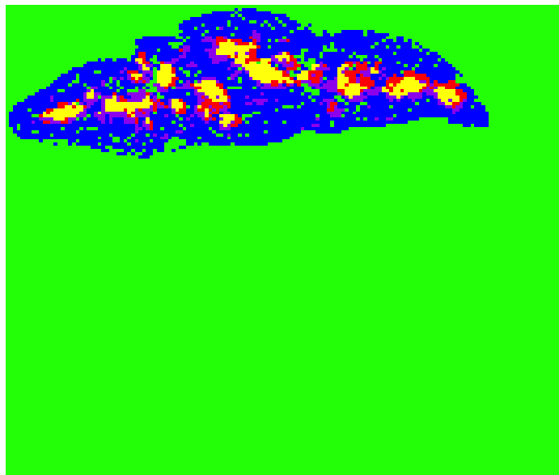
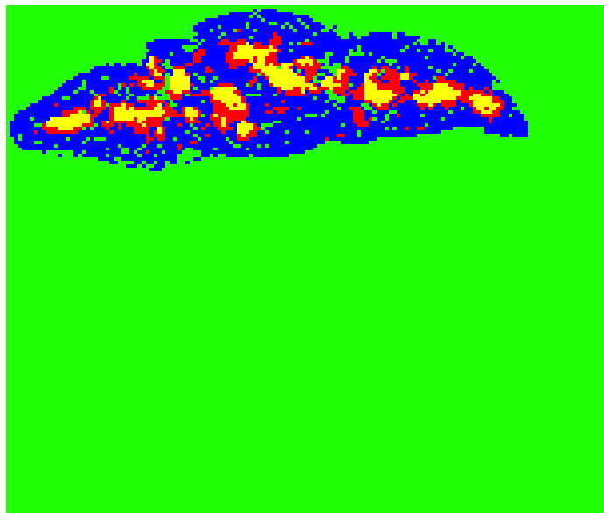
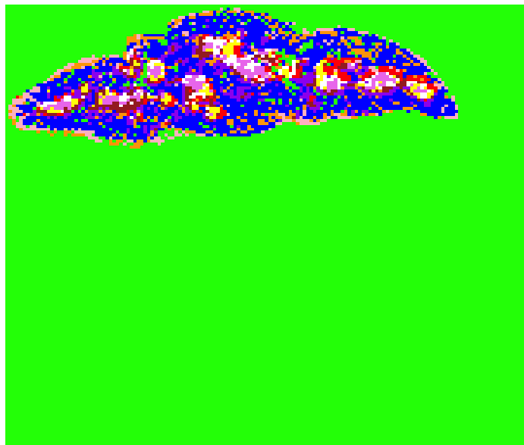
Clustering Results K=4 K=5 K=10

Slide 14
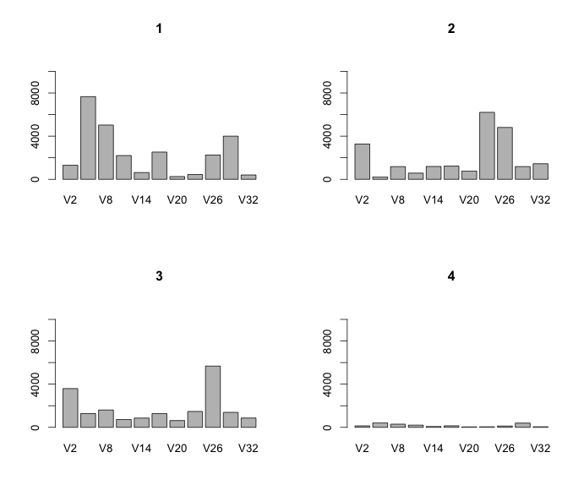
How is clustering being done?
Green
Blue
Red
Yellow
Number of Cells
Cell markers
Cell markers
Number of Cells
Cell markers
Number of Cells
Cell markers
Number of Cells
Cell markers

Slide 15
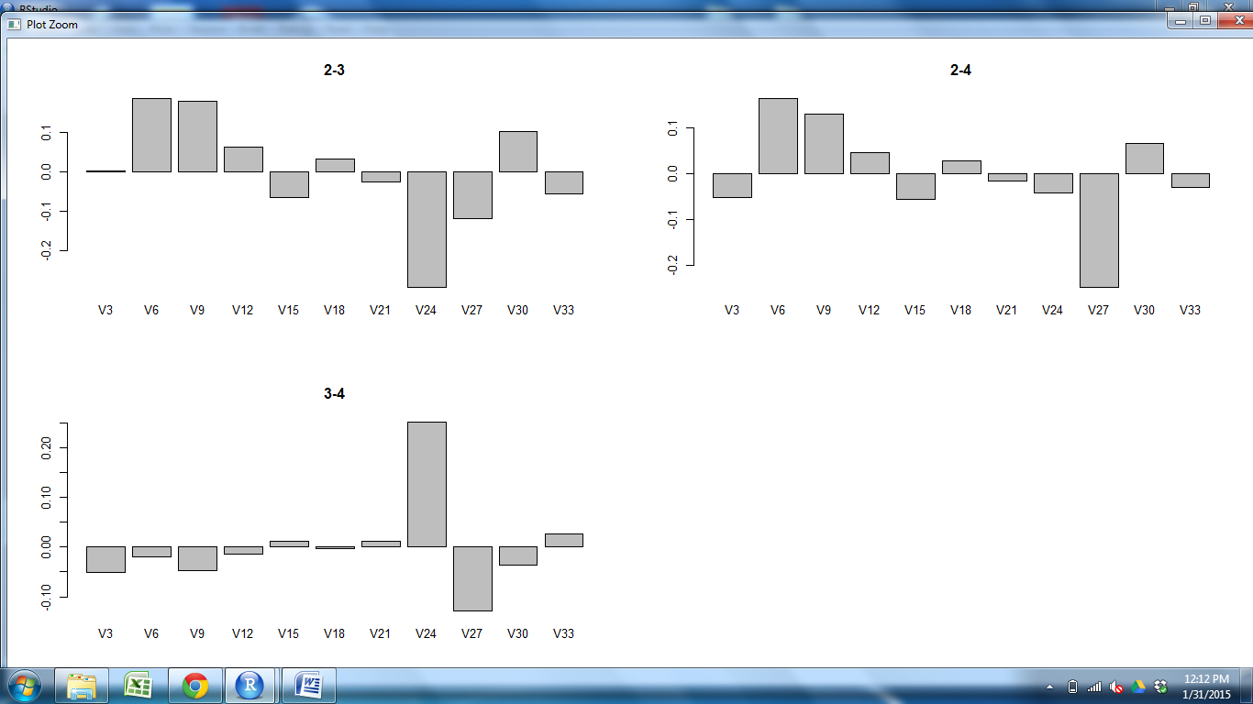
Comparing Clusters
Yellow vs Red
Cell abundance
CD205
CD25
Claud34
Claud5
Foxp3
K14
K5
PDGFRb
UEA1
CD11c
CD31
Cell markers

Slide 16
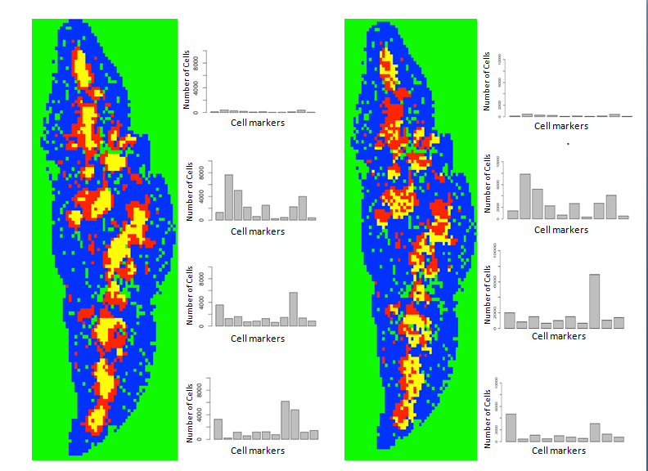
Remove cell types-K14 (mTEC subset)
Original Minus K14
Green
Blue
Red
Yellow
Green
Blue
Red
Yellow

Slide 17
Goal: Develop a quantitative model to characterize the spatial organization of cell types in a mouse thymus.
Spatial and compositional clustering (K means)
Use an ecological index on different regions that are produced
Notes:
K Provides Useful compositional and geographical information, but Graphs descriptive
Begin to APPLY ECOLOGICAL methods to the thymus
In ecology, different INDICIES that you can use to COMPARE the IDENTITY and relative ABUNDANCE of species across communities
The Bray Curtis Dissimilarity Index in particular is a well characterized statistical method that looks at compositional dissimilarity between sites based on cell counts
0 = identical (same composition), 1=don’t share any species; typically multiplied by 100 and given as a percent
Use this index to determine how similar clusters produced from K means
make comparisons with sections in same thymus and between thymuses

Slide 18
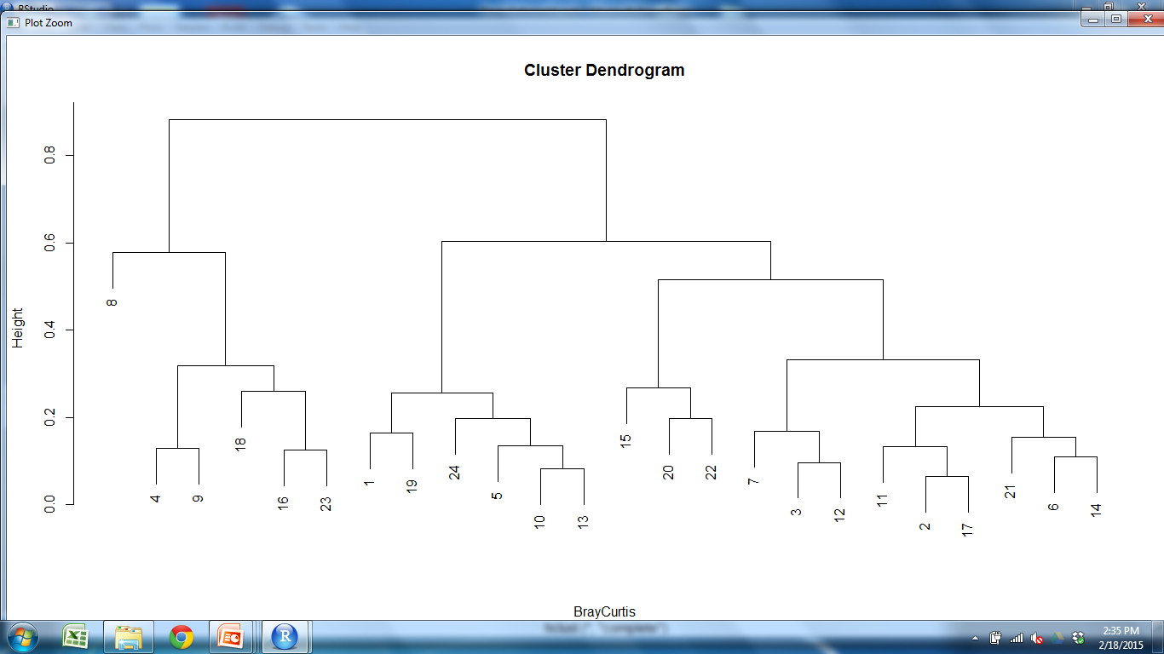
Bray Curtis Dendrogram
OUTER CORTEX MEDULLA1 MEDULLA2
Key
WT1=
WT2=
M2S3 M2
Conclusion
Consistent grouping of clusters which correspond to same region
WT samples are compositionally similar to other WT samples

Slide 19
Goal: Develop a quantitative model to characterize the spatial organization of cell types in a mouse thymus.
Spatial and compositional clustering (K means)
Use an ecological index on different regions that are produced
Repeat with Mutant

Slide 20
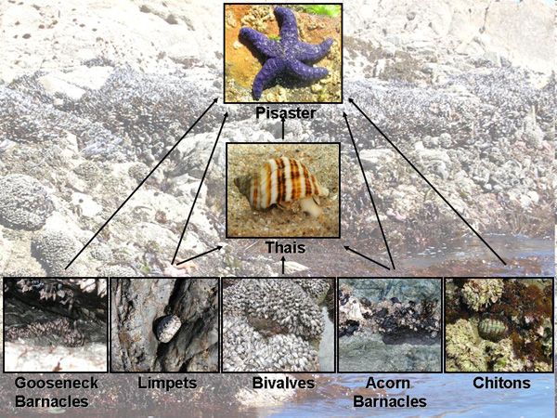
Removal of a “Species”
Keystone species
http://www.nature.com/scitable/knowledge/library/keystone-species-15786127
Notes:
Can compare remove of cell type to removal of species in community; can expect several different results
EXAMPLE OF TYPICAL MARINE ECOLOGY COMMUNITY
Similar to Keystone species=removal completely alters organization and composition of community; wildly different-STARFISH
species are still there but there are changes in organization
still important but doesn’t produce any noticeable organizational effects

Slide 21
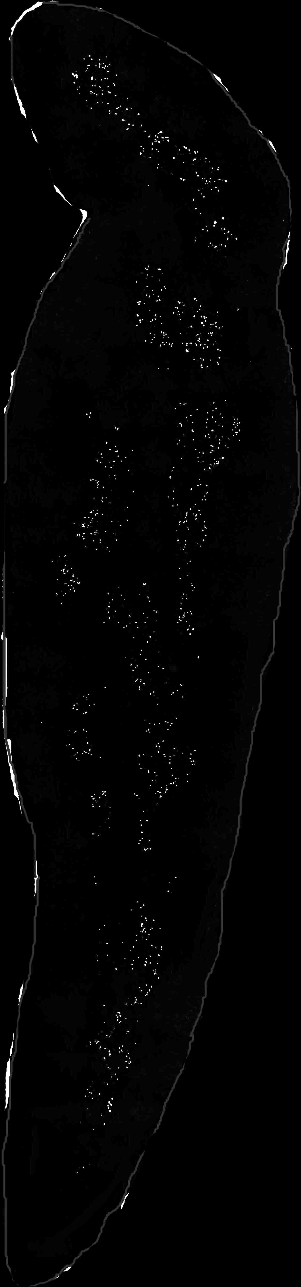
AIRE
Regulator of
tissue restricted
antigens in mTECs
Key modulator of
mTEC differentiation
APECED Autoimmune Syndrome in humans
REMOVAL OF AIRE
Doubling of
K14+ mTEC
Altered shape and
decreased abundance
of UEA1+ mTEC
Reduced number
of T-regulatory cells
Reduced dendritic cells
in medulla; increased
density at CMJ
K14 UEA1 CD11c Foxp3

Slide 22
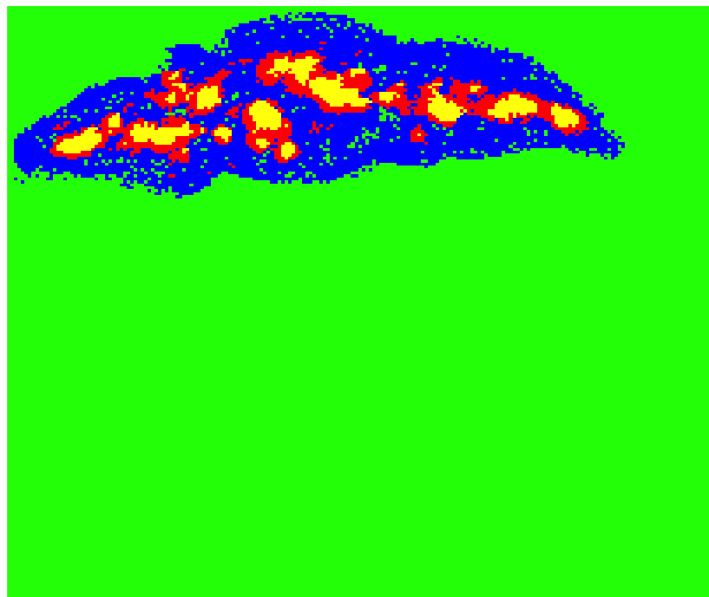
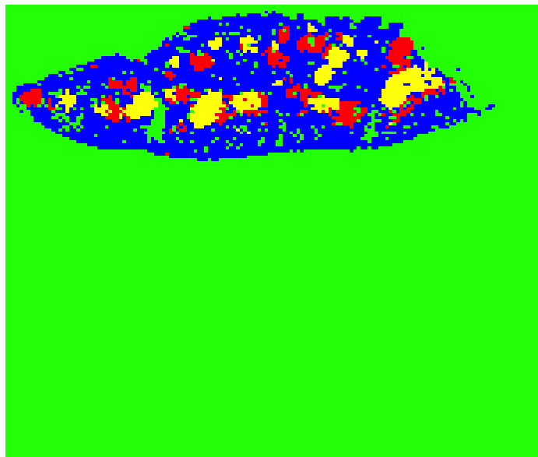
WT Mutant

Slide 23
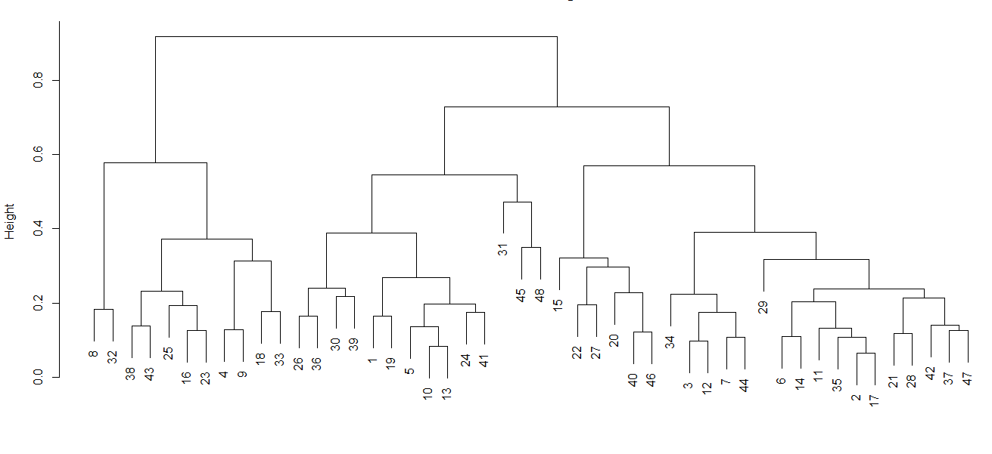
Bray Curtis Dissimilarity Index
OUTER CORTEX MEDULLA1 MEDULLA2
Key
WT1= Mutant1=
WT2= Mutant2=
Conclusion:
Consistent grouping of clusters that correspond to same region
Wild-type and mutant clusters are interspersed; not separated based on genotype
Samples are compositionally similar

Slide 24
Goal: Develop a quantitative model to characterize the spatial organization of cell types in a mouse thymus.
Spatial and compositional clustering (K means)
Repeat with mutant
Use an ecological index on different regions that are produced
Look at spatial relationships between clusters

Slide 25
Is organization of clusters different between WT and Mutant?
WT Mutant

Slide 26
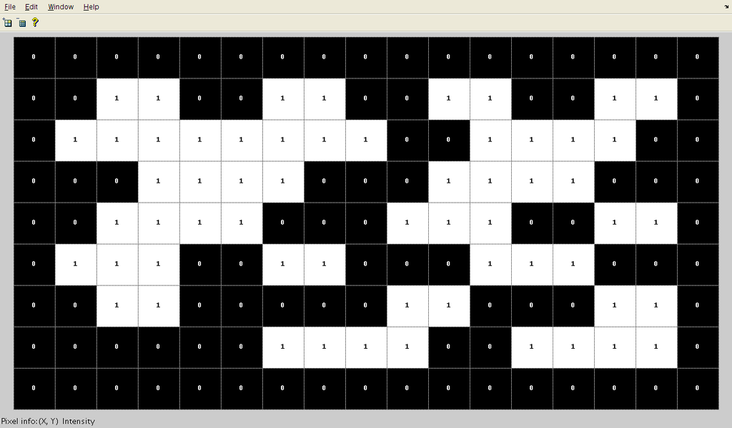
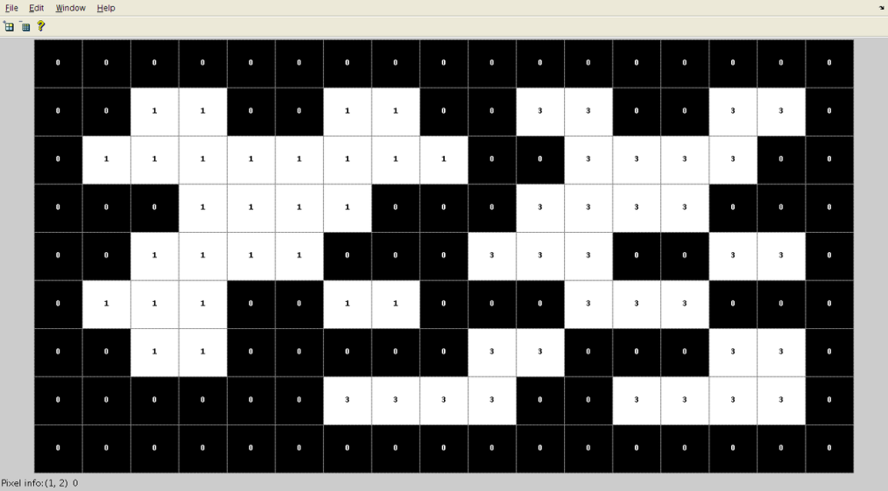
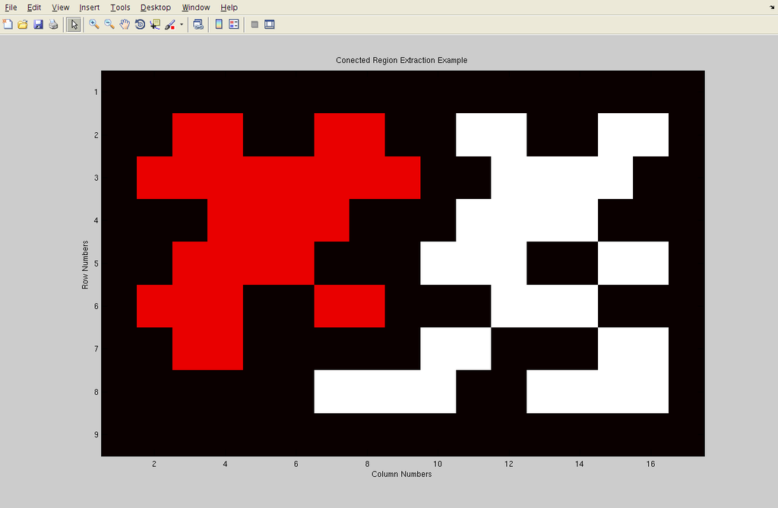
Connected Component Labeling (CCL)
2
2
2
2
2
2
2
2
2
2
2
2
2
2
2
2
2
2
2
2
2
2
2
2
2
2
2
2
2
2
2
2
NUMBER OF CLUSTERS
SIZE DISTRIBUTION
CENTROID
DISTANCE BETWEEN CENTROIDS
http://en.wikipedia.org/wiki/Connected-component_labeling
Notes:
CCL to quantify: Works by identifying components that are connected and giving them a unique label
Matrix containing 0s and 1s
CCL SCANS MATRIX, groups components that are connected, and gives them a UNIQUE LABEL (number, color)
Perform different CALCULATIONS on these components

Slide 27
Is organization of clusters different between WT and Mutant?
WT Mutant
CCL Average (pixels)
WT Mutant
3.95 5.84
Notes:
Connected component labeling-technique Identify individual cluster components for each cluster;
find centroid (center of mass) for each cluster component for yellow and nearest red cluster and find distance bt them
WT=centroid in center; small distance between: M2 is inset in M1
Mutant-adjacent, further distance between ; offset from

Slide 28
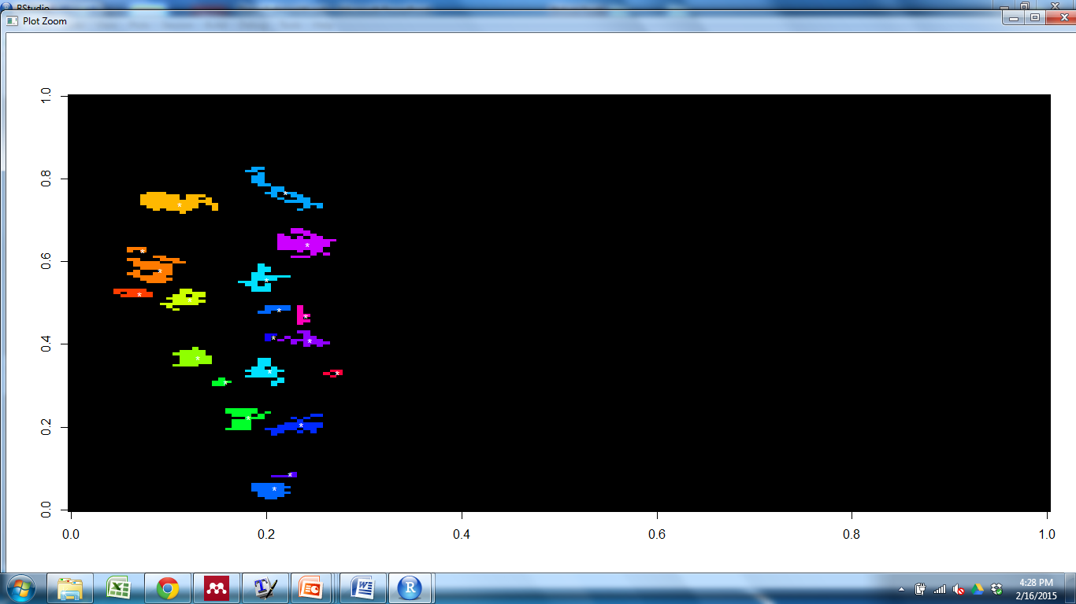
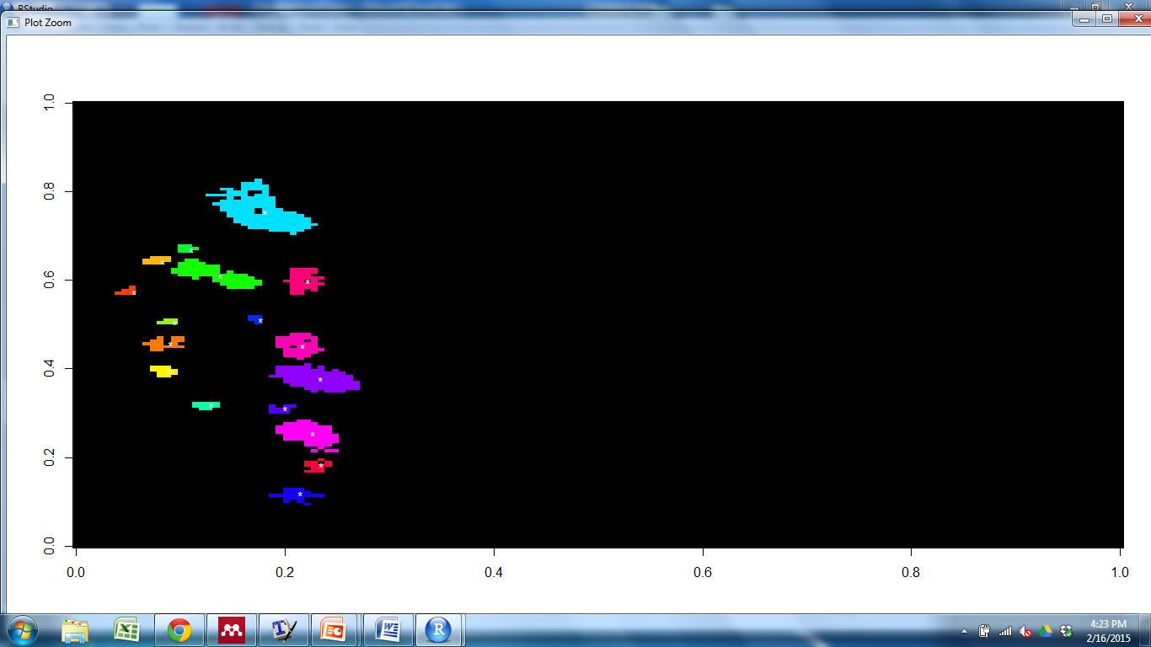
Connected Component Labeling-Mutant1
RED
YELLOW

Slide 29
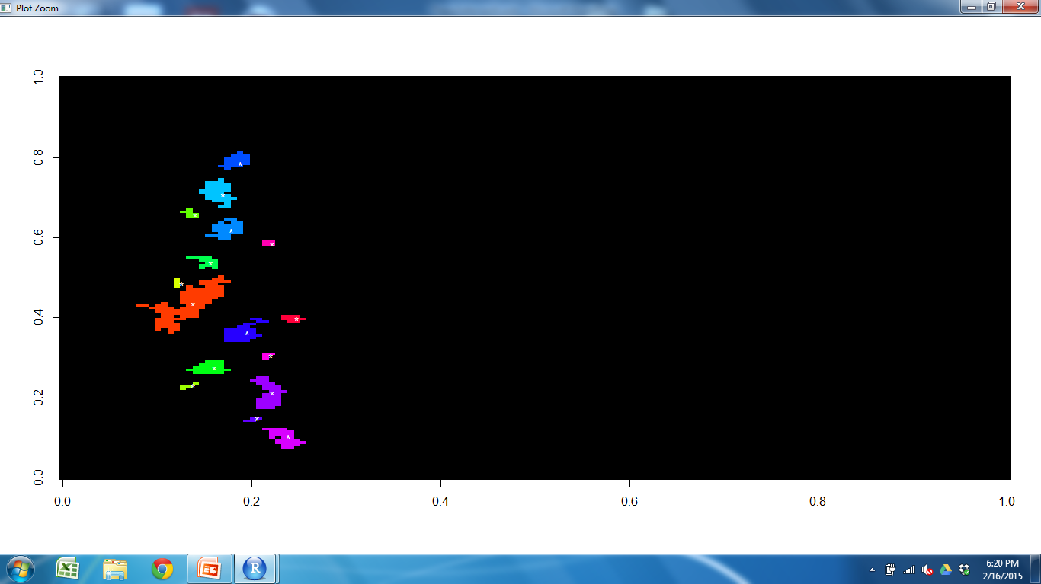
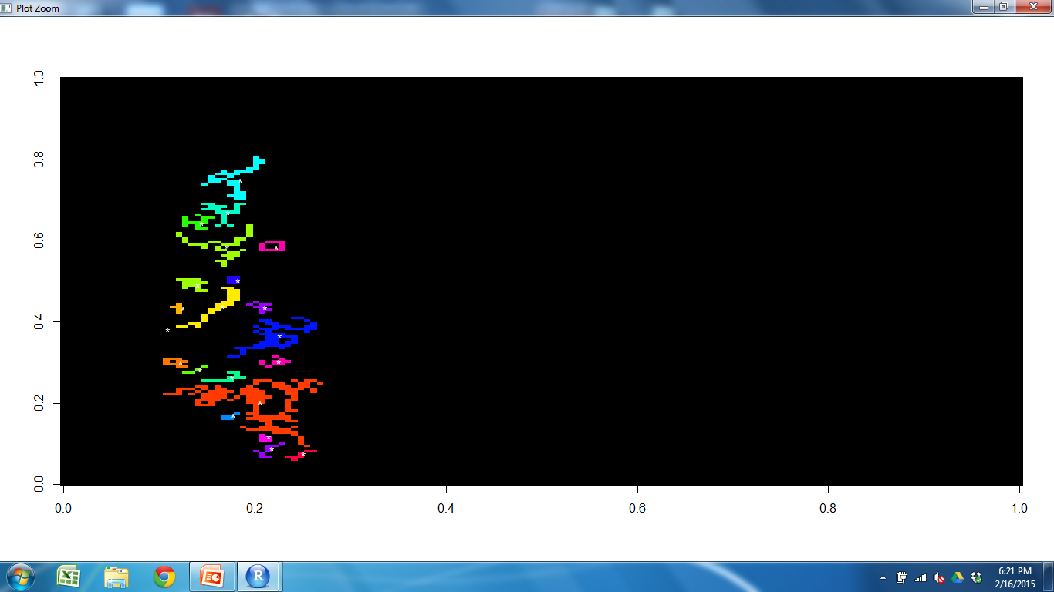
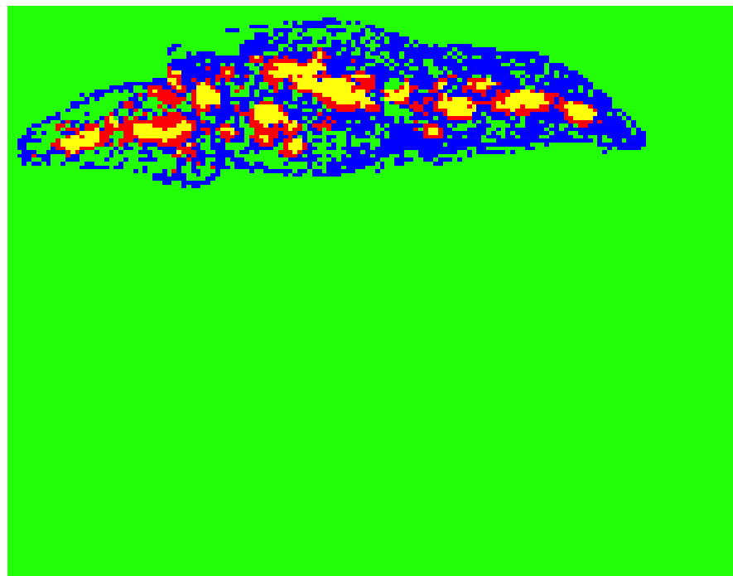
Connected Component Labeling Results
YELLOW
RED

Slide 30
Conclusions
We have developed a method to quantitatively evaluate organization of cell types in the thymus
Wild-type clusters were compositionally similar to other wild-type samples
Mutant clusters were compositionally similar to wild-type; possible spatial difference
Need more samples to draw conclusions

Slide 31
Future Directions
Further Analysis
Increase sample size
Manipulate K
Removal of cell types from dataset
Test different mutant/involuted thymus
Try different statistical measures

Slide 32
Acknowledgements
Committee:
John Wares
Nancy Manley
Andrew Park
Brian Condie
Lab Members
Manley Lab
Wares Lab
Jena Chojnowski
Julie Gordon
Kristina Buac
https://introhumanbrain.wordpress.com/inclass-projects-quizes/project-10-ish-database/
http://en.wikipedia.org/wiki/Histology
http://www.histology-world.com/photoalbum/displayimage.php?album=33&pid=667
http://en.wikipedia.org/wiki/Immunohistochemistry

Slide 34
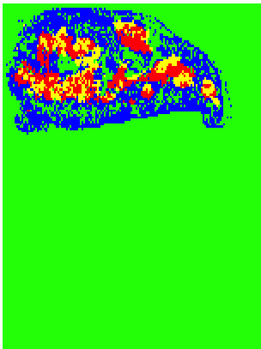
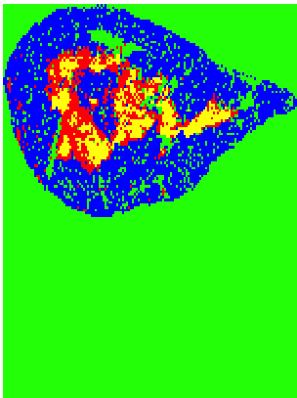
WT WT Mutant Mutant
Notes:
M1 surrounds M2 in WT, adjacent in Mutant; organization of clusters appears to be different; quantify organization difference
Connected component labeling-technique Identify individual cluster components for each cluster; Manually find centroid (center of mass);
measure distance between red and yellow cluster components
WT=centroid in center; small distance between: M2 is inset in M1
Mutant-adjacent, further distance between ; offset from
Still refining method to work with dataset; way of identifying clusters with CCL is imperfect.
Although mutant looks different, we need to increase sample size to make sure this is real; draw conclusions

Slide 35
Virtual Sections
Antibody Set 1
Antibody Set 2
Antibody Set 3
Virtual section
Collapse 3 virtual sections= virtual slice

Slide 36
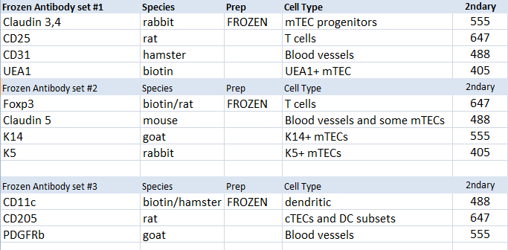
Combinations of Antibodies Finalized List-Frozen 11 cell types

Slide 37
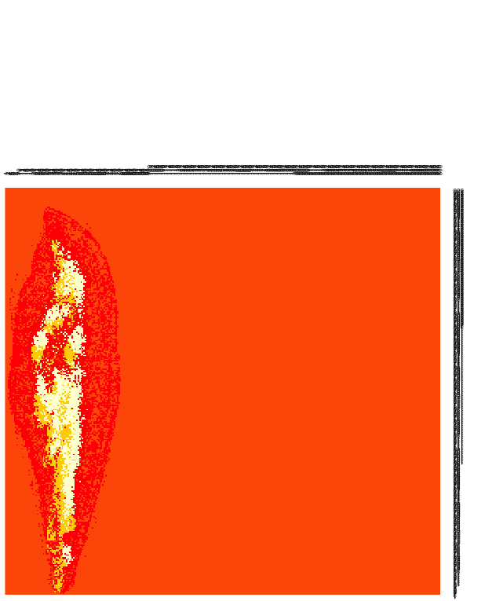
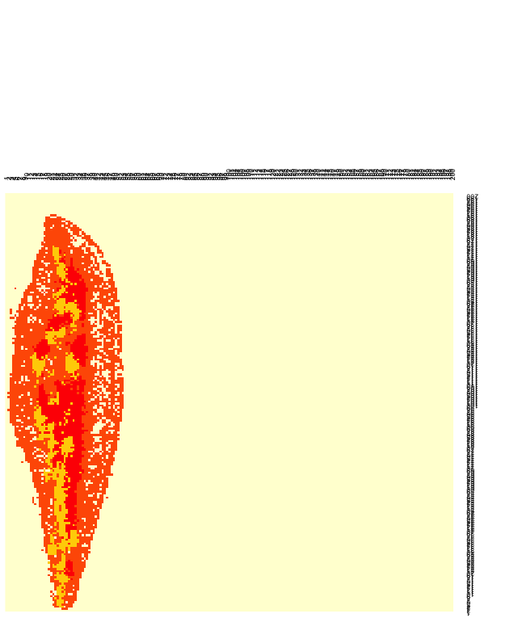
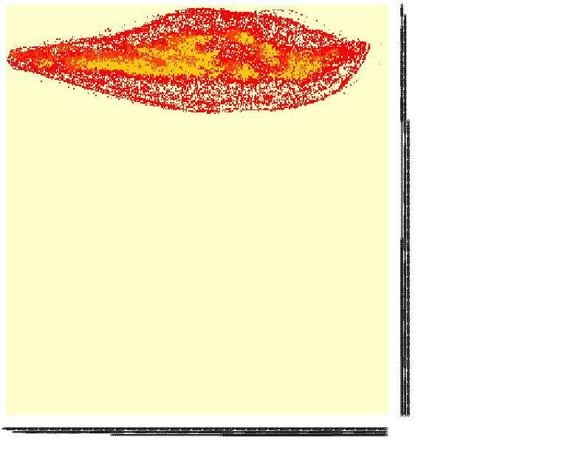
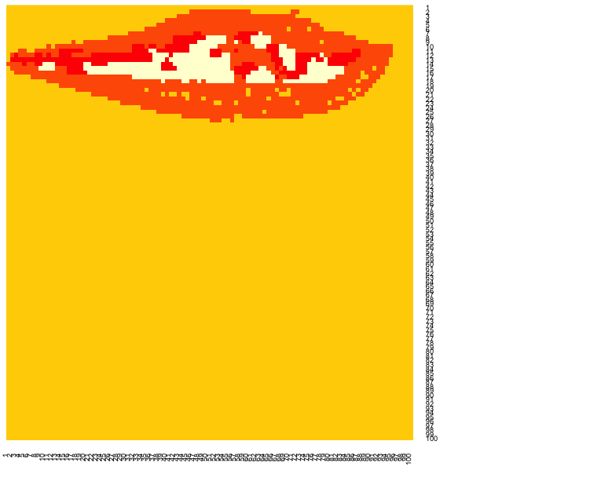
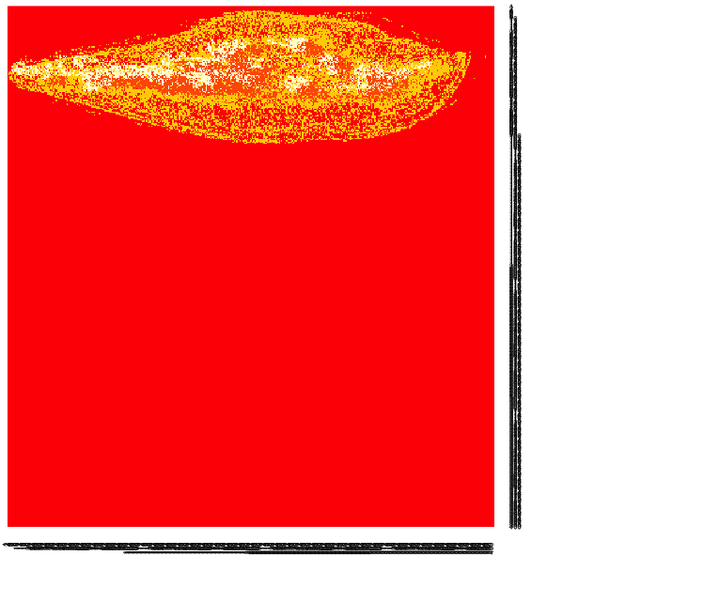
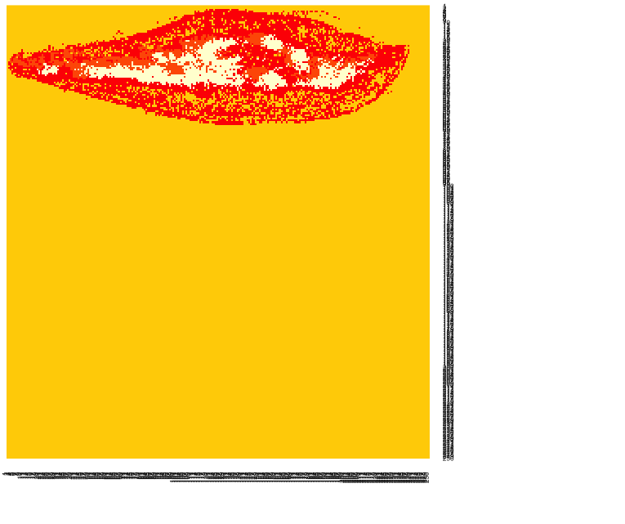

Different bin sizes (K=4)
400x400 350x350 300x300 250x250 200x200 150x150 100x100
Which bin size is optimal?
Notes:
First time I did analysis, I Randomly picked 200x200, cell counts in each bin were reasonable number (not too high or low)
Not good reason, Need something to support this number

Slide 38


Rarefaction Curve
Area (mm2) | BINS
0.00022 | 500x500
0.00027 | 450x450
0.00035 | 400x400
0.00045 | 350x350
0.00062 | 300x300
0.00089 | 250x250
0.00139 | 200x200
0.00247 | 150x150
0.00555 | 100x100
0.0222 | 50x50
Notes:
Determining the optimal quadrant size: Rarefaction
Rarefaction-technique used in ecology to assess species richness (# of species) from the results of sampling.
The issue that occurs when sampling species in a community is that the larger the number of samples, the more species that will be found.
When have you collected enough samples? (when is the bin size small/large enough) large bin size=more samples, get to point where you will lose info
Want to find the smallest unit of area that still contains useful information, construction of rarefaction curves,
Selected 5x5 quadrants and took average over a section of thymus that contained #of cell types (as opposed to # of cells). I did this 8 times in cortex and 8 times in medulla (since medulla had higher cell counts than cortex) and took average of that
Steep slope indicates that a large fraction of the species diversity (cell types) remains to be discovered.
When the curve becomes flatter to the right, a reasonable number of individual samples have been taken: more sampling is likely to yield only few additional species.
Saturated for medullary region when curve plateaus, probably won’t have all 7 cell types in the cortex (medullary markers)

Slide 39

CellProfiler Results-Blood vessel marker
CD25
Notes:
Input images from Ptgui into Cellprofiler to get cell counts which will be used for analysis
Real signal, Intensity of fluorescence
Different colors = different cells,
Finds centroid of cell and outputs x and y location
This shows a zoomed in portion of the thymus so you can see what CP considers to be a cell
Green is what CP detects bc of parameters I set, centroid!
Take cellprofiler results, reformat, use them in R
Place grid over thymus section and record # of cell for each cell type that fall into each box of the grid

